Slide 1
AMU E-connect
“As connection evolve, so does people."
By Suhel Khan
Department of Computer Science

Slide 2
Content
Introduction
Problem Statement
Study of Existing System
Scope of the Project – Inclusions, Exclusions
Tools and Technologies
Software Architecture
Appendices
Conclusion
AMU eConnect

Slide 3

Introduction – AMU e-Connect
Web Based Application
Dedicated platform for connecting AMU’s alumni
About alumni details
Fully Responsive
Ease of Use

Slide 4

Problem statement
Lack of one to one connection.
Complexity and not that friendly.
No dedicated platform for getting details of AMU alumni.
Social media is general purpose.

Slide 5
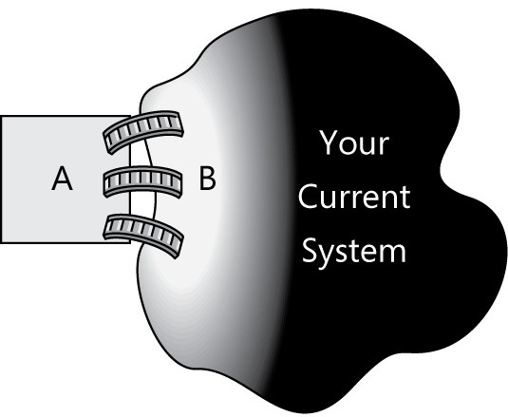
Study of existing system
Mostly focused on institution.
Complex and not that friendly.
Do not provide functionality
of connecting individuals.

Slide 6

Scope of Project
Inclusions:
User Authentication – Login/Registration
Profile creation and management
Alumni Search
Exclusions:
No Real time communication
No chat functionality as of now.
Future Scope
Blog functionality
WebRTC

Slide 7









Tools and technologies
Programming Language:
Python
Development Tools:
PyCharm – Probably best IDE for development.
Flask – Python’s micro web framework.
Jinja2 - A templating engine.
Database:
SQLite3 - Lightweight
Additional Technologies:
HTML, CSS, JavaScript
Bootstrap

Slide 8
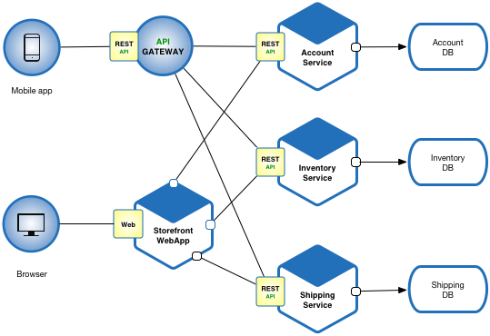
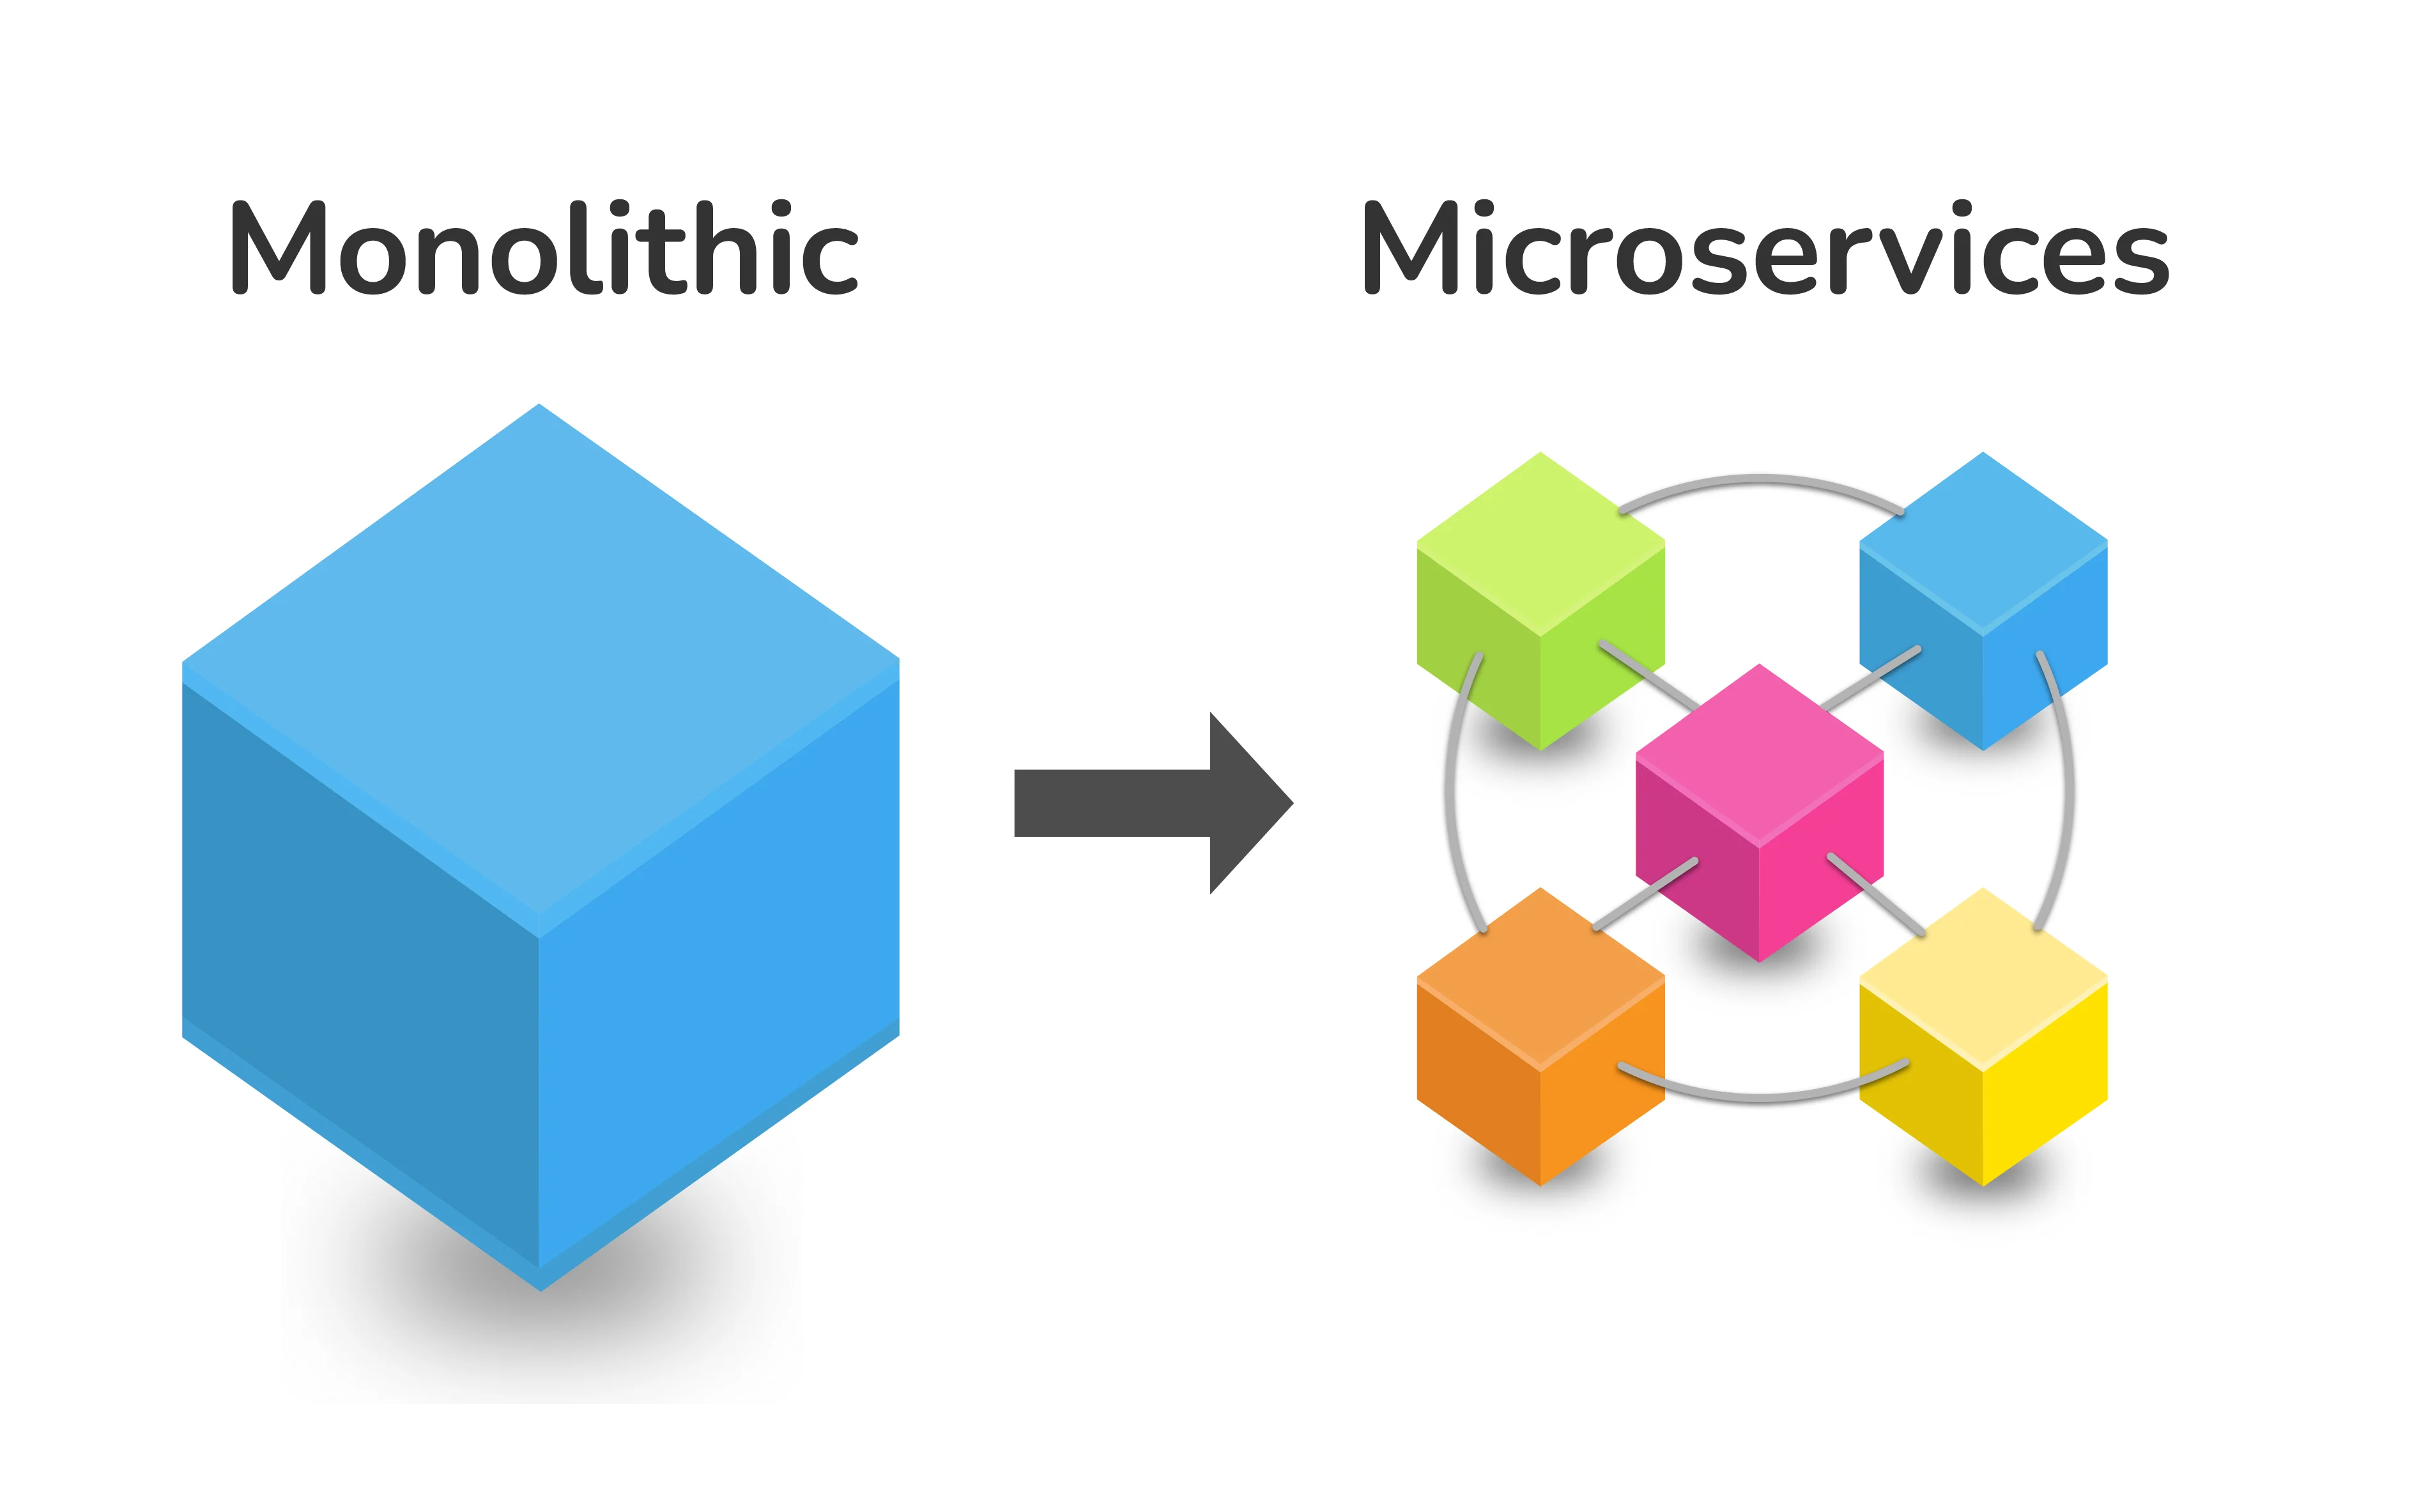
Software Architecture
Microservice Architecture:
“Approach to develop a single application
as loosely coupled small services.”
Monolith vs Microservice

Slide 9
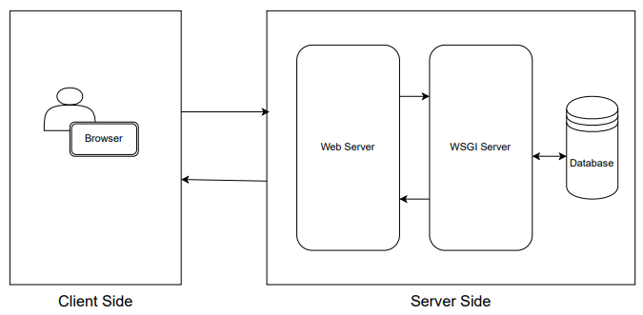
Appendices
High Level Architecture

Slide 10
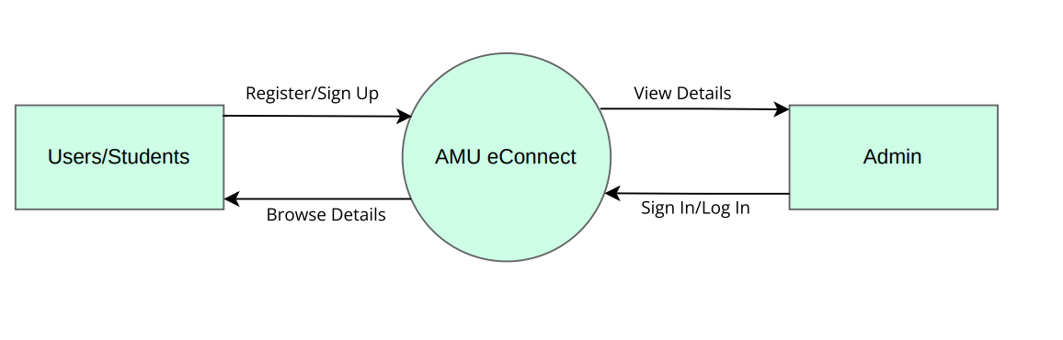
Appendices
Data Flow Diagram (DFD)

Slide 11
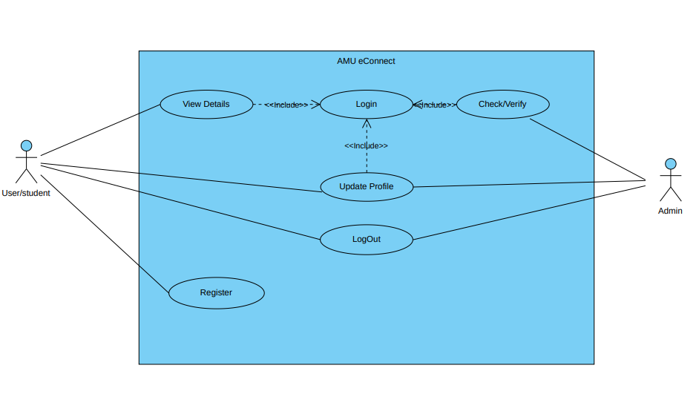
Appendices
Use Case Diagram

Slide 12
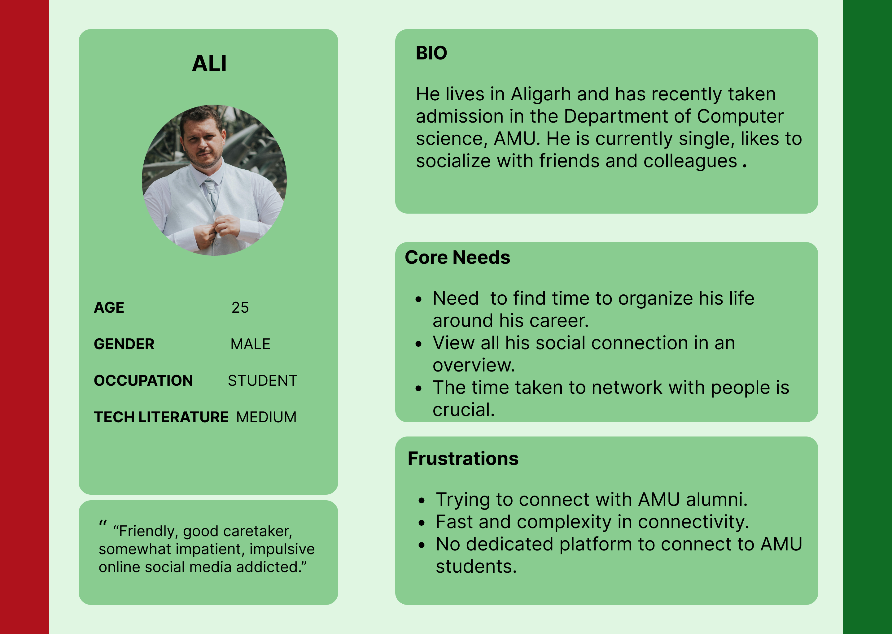
Appendices
User Persona

Slide 13
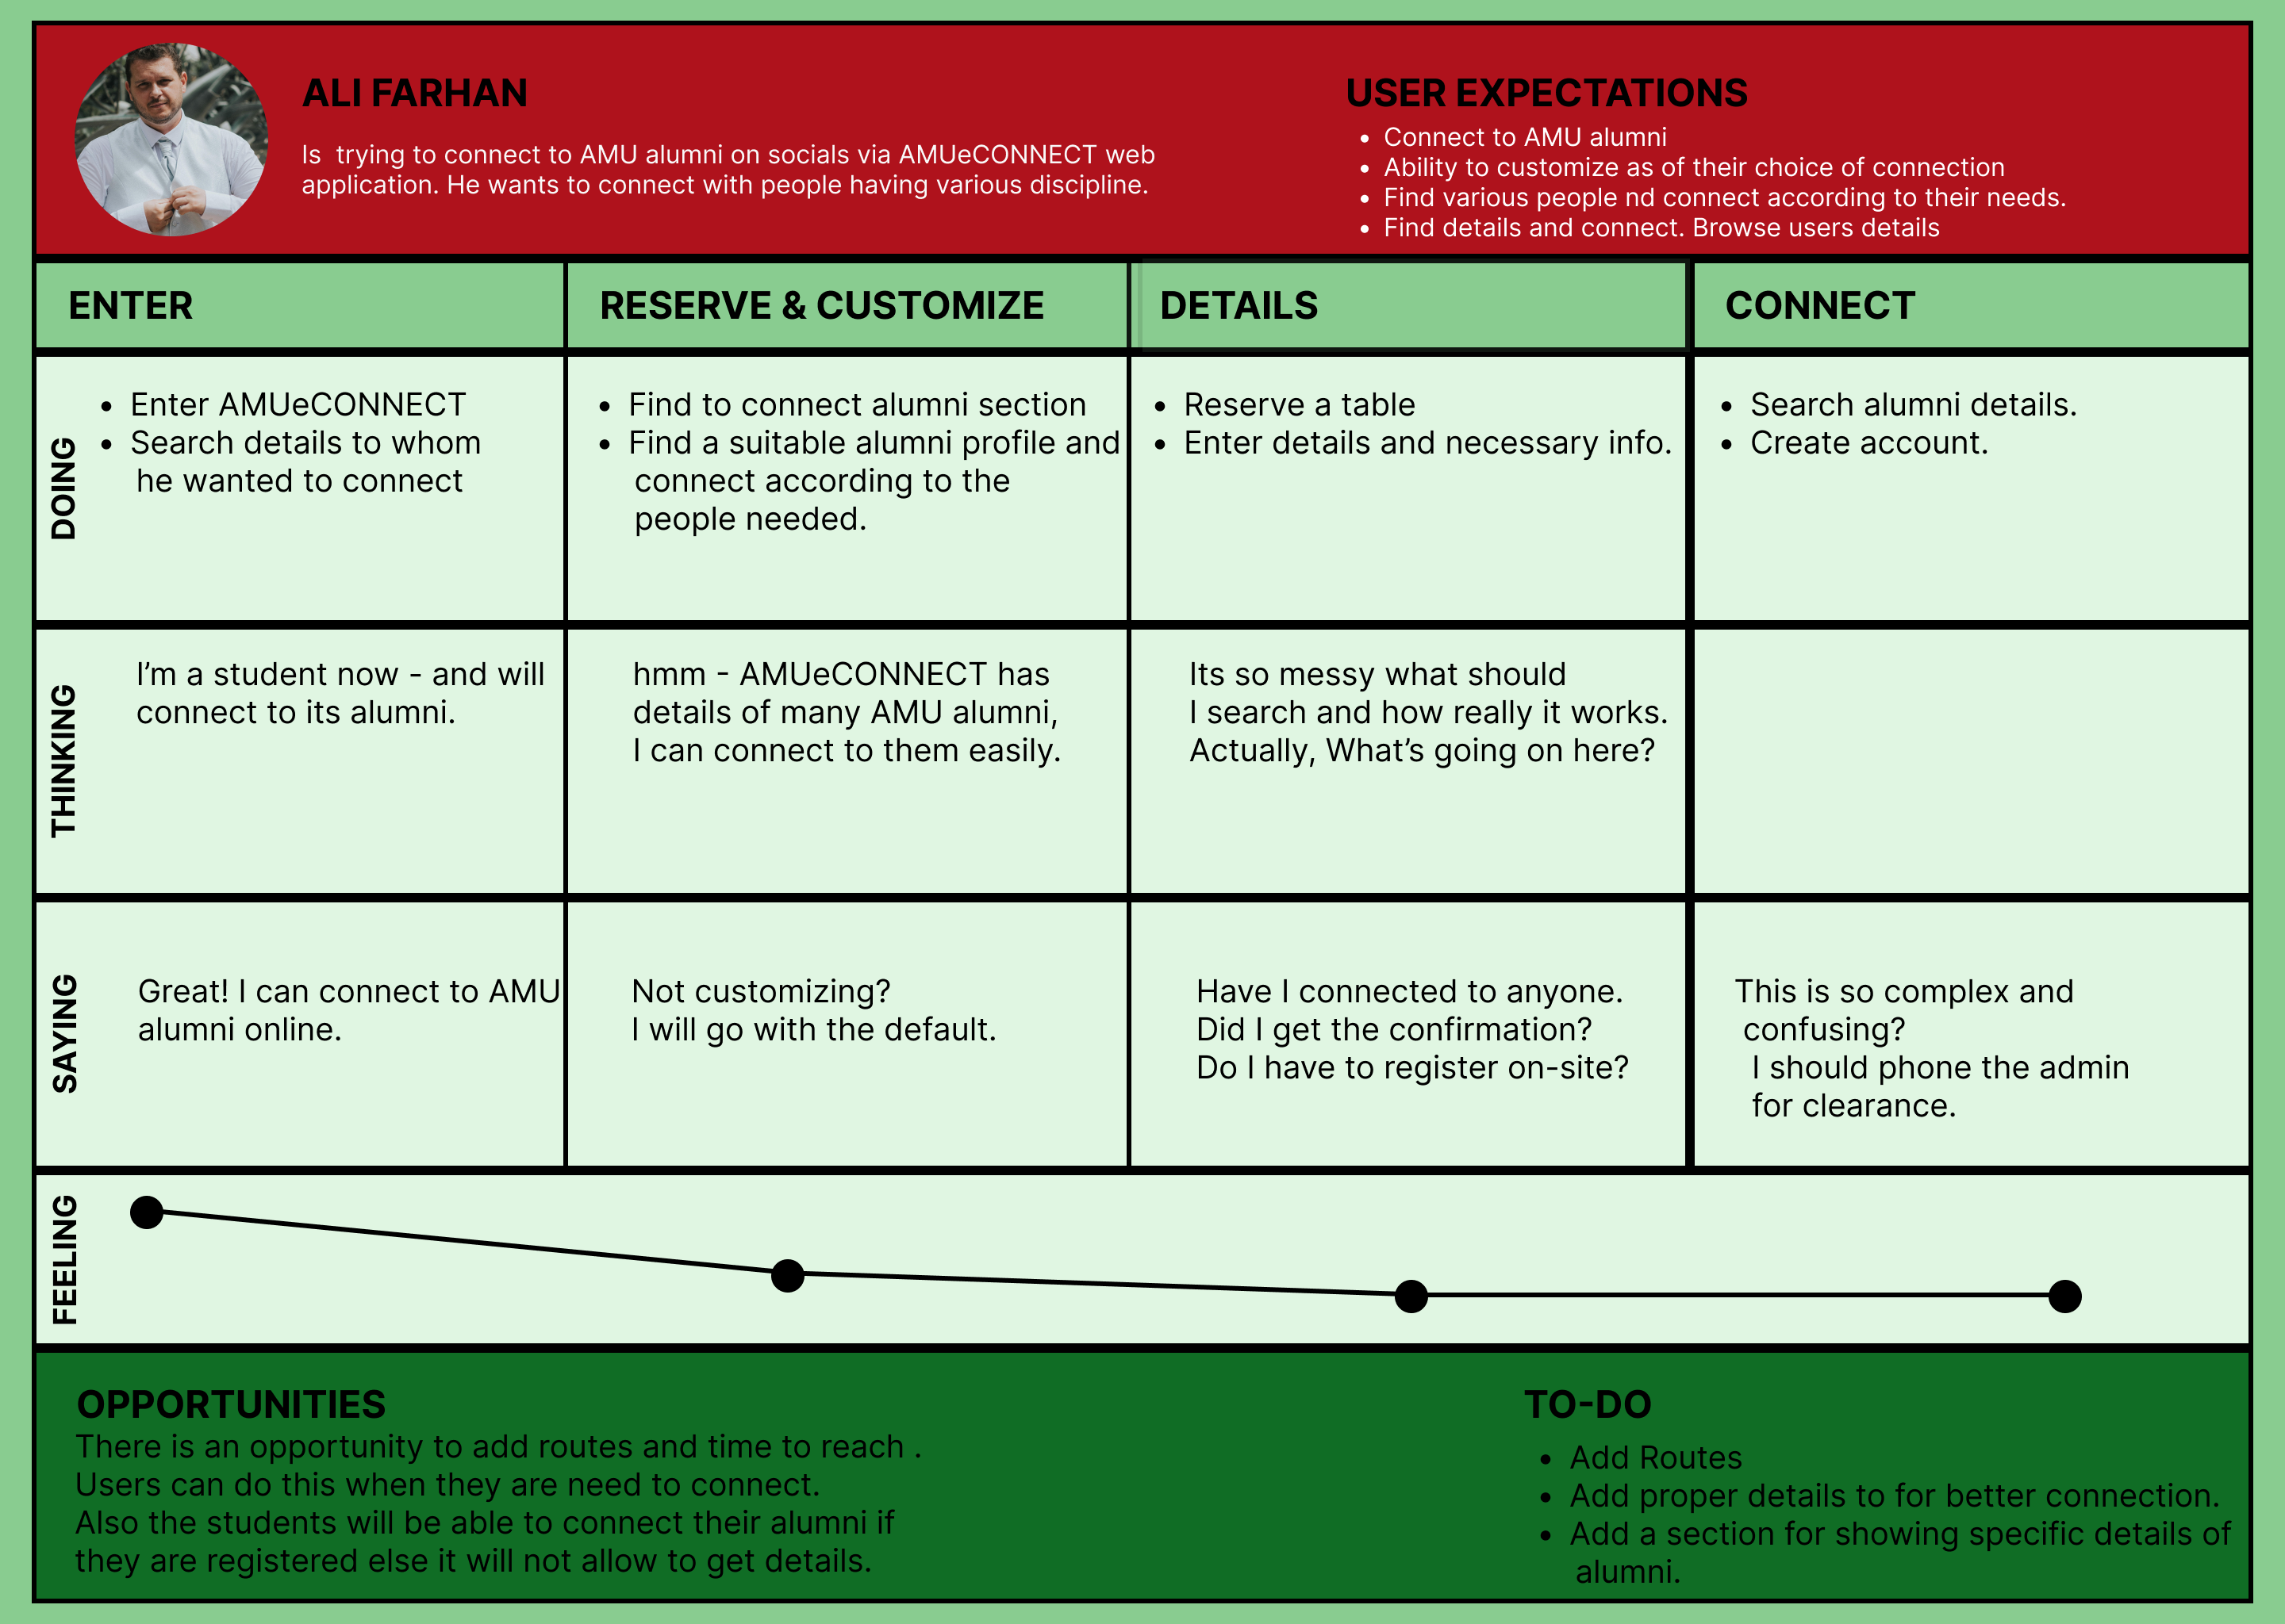
Appendices
User Journey Map

Slide 14
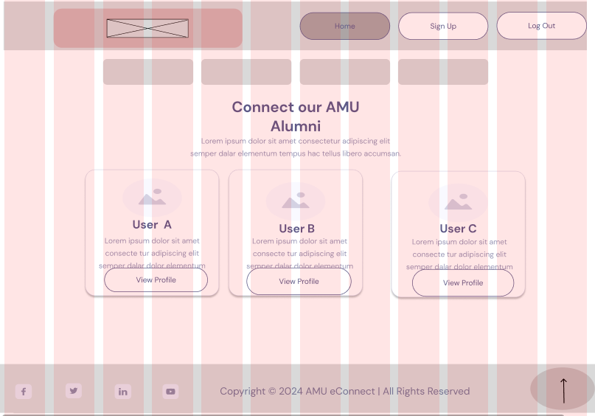
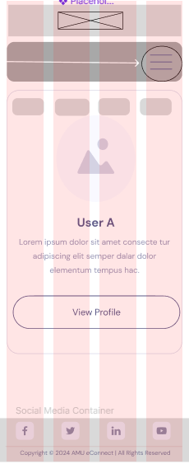
Appendices
Wireframes – Home Page

Slide 15
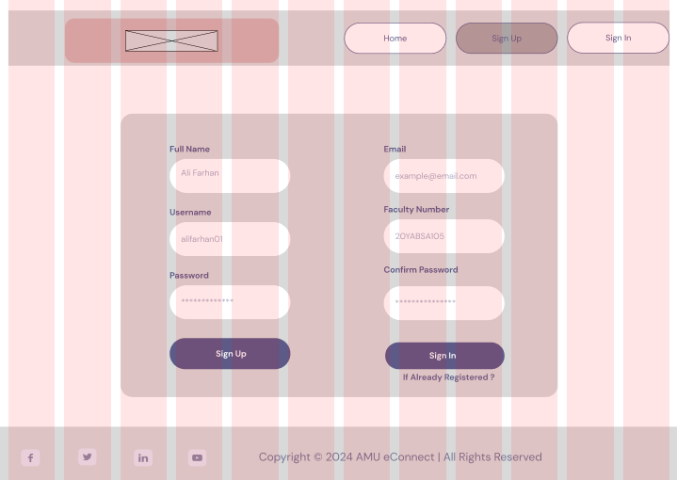
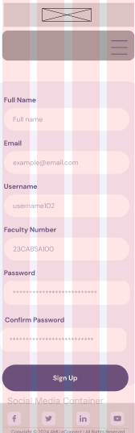
Appendices
Wireframes – Registration Page

Slide 16
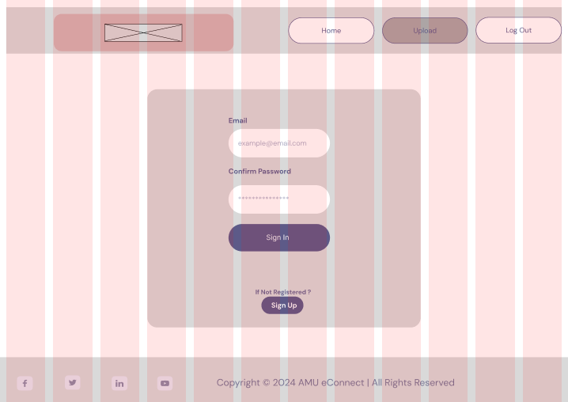
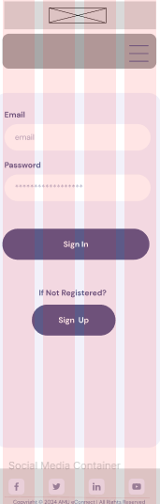
Appendices
Wireframes – Login Page

Slide 17
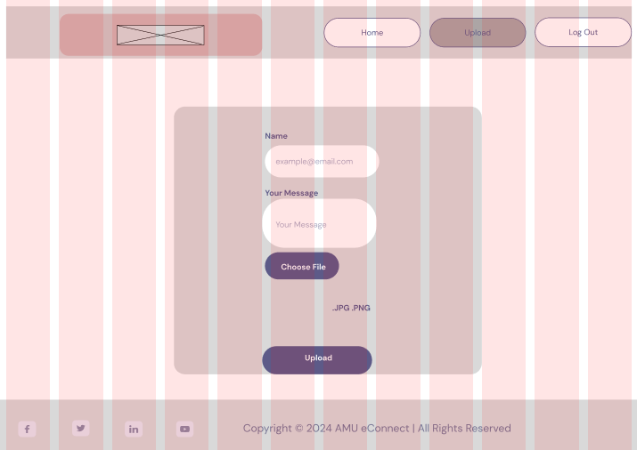
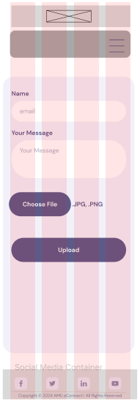
Appendices
Wireframes – Upload Page

Slide 18
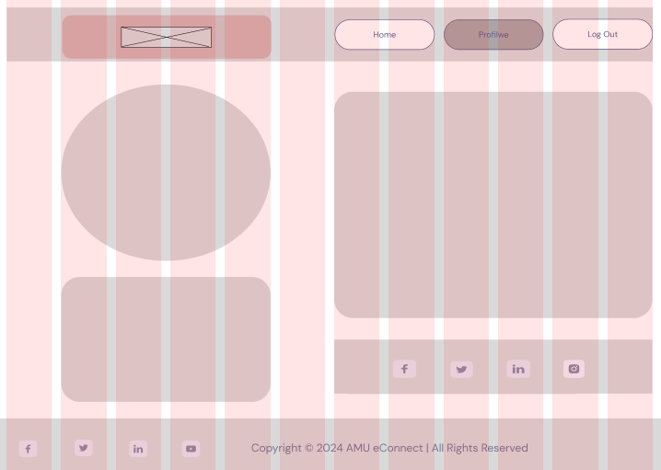
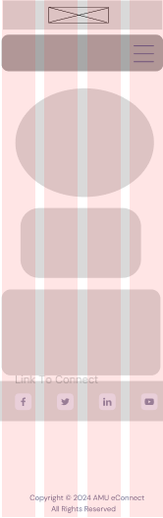
Appendices
Wireframes – Profile Page

Slide 19
The End
Thanks for listening!

